Slide 1
Basic Introduction to Python
Python - The most demanding Language in the market

Slide 2
Abhishek Singh
Email-Id : abhisinghdeveloper@outlook.com
Website : AbhiSinghDeveloper.github.io
LinkedIn : https://www.linkedin.com/in/abhishek-developer/
GitHub : https://github.com/AbhiSinghDeveloper

Slide 3
What we are going to know after this session?
What is Python ?
Who developed Python ?
History of Python.
Difference between Python and other Programming Languages (like Java )
Advantages of Python.
Disadvantages of Python.
Scope of Python.
Which are the companies that use Python?
What can we do with Python?
Installation of Python.
Writing up your First Program in Python.
Running our first Python Program.

Slide 4
What is Python ?
Interpreted, object-oriented, high level programming language.
Simple, easy to learn syntax.
Dynamically typed.
Shorter than equivalent programs of other languages.
Provides an increased productivity.

Slide 5
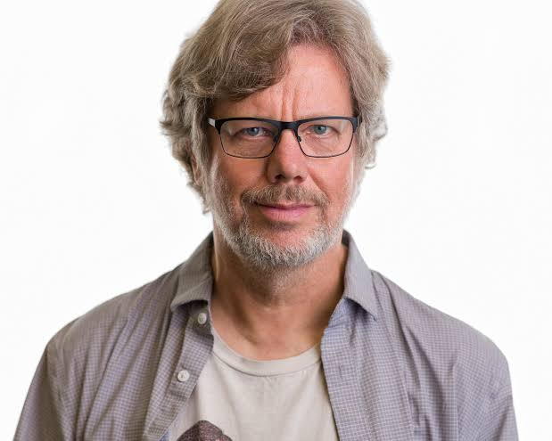
Who developed Python?
It was created by Guido van Rossum and first released in 1991, but it was not that famous back then. It has become one of the most popular programming languages in the world near about 2006.

Slide 6
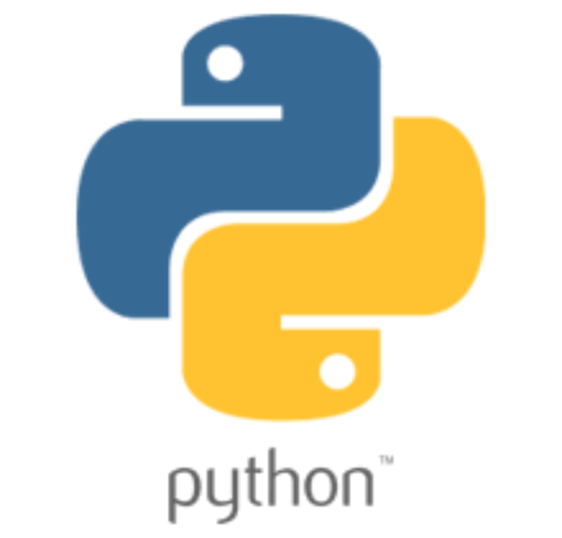
History of Python
Conceived in late 1980’s.
Implementation was done in 1991.
Python 2 was released on Oct 16, 2000 with many new features.
It was not so famous back then, it became famous in 2006 when Google started using Python.

Slide 7
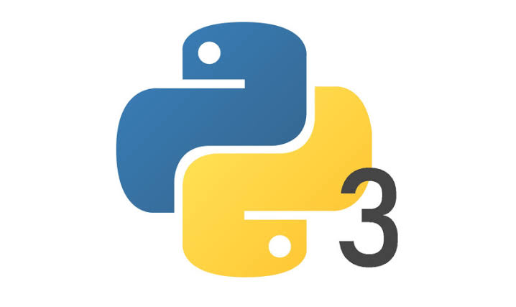
Latest Version of Python
Python 3.0, was released on December 3, 2008, after a long period of testing.
Many of its major features have also been backported to the backwards-compatible, while by now unsupported, Python 2.6 and 2.7
Many new versions of Python were released from then, The latest version today available for download is Python 3.8.5

Slide 8
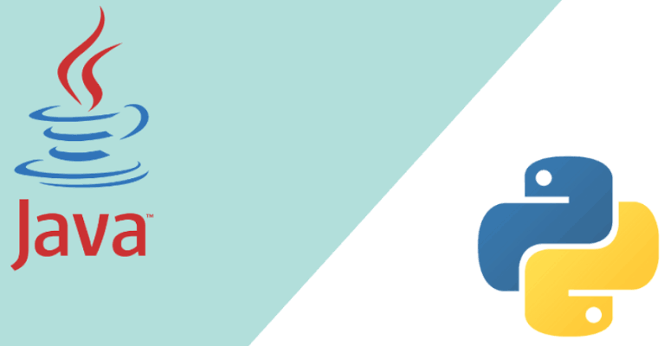
Difference between Python and other languages
The distinguishing features of python:
Dynamically typed
Interpreted
White space indentation
First class functions
Decorators
Ease of learning
It is the best scripting language, and yet not limited to only scripting. You can build huge applications in python quite elegantly.

Slide 9
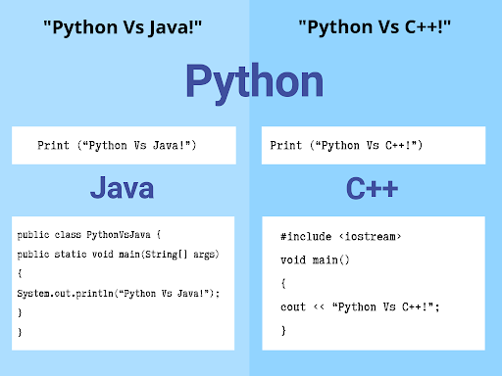
Comparison between Java, C++ and Python

Slide 10
Advantages of Python
Disadvantages of Python
Versatile, Easy to Use and Fast to Develop.
Open Source with a Vibrant Community.
Has All the Libraries You Can Imagine.
You can Do More with Less Code.
Speed Limitations.
Problems with Threading.
Not Native to Mobile Environment.
Speed: Python is slower than C or C++.
Memory Consumption: Python is not a good choice for memory intensive tasks.
Memory Consumption: Python is not a good choice for memory intensive tasks.

Slide 11
Scope of Python
Web Development: Django, Flask, Pyramid, Bottle, Tornado
GUI Development: tkInter, PyGObject, PyQt, PySide, Kivy
Scientific and Numeric: SciPy, Pandas, IPython
Software Development: Buildbot, Trac, Roundup, CPython
System Administration: Ansible, Salt, OpenStack
Machine Learning, Deep Learning, Artificial Intelligence
And MANY more…...

Slide 12
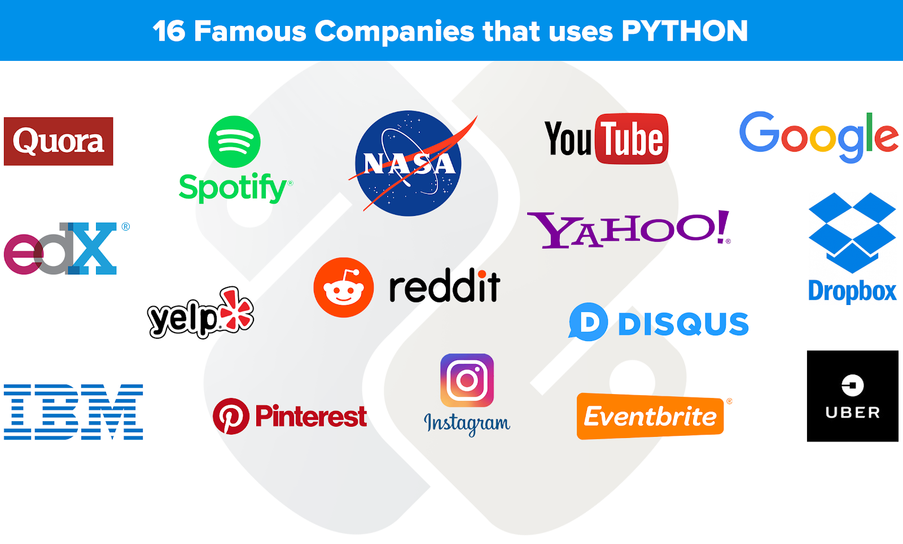



Various Companies that use Python
Google
Facebook
Instagram
Spotify
Quora
Netflix
Many more

Slide 13
What can i do with Python?
Machine Learning
Data Science
Block Chain
Web Development
Software Development
Game Development
Web Scraping

Slide 14
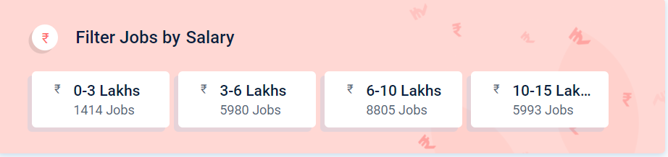
Average Salary of a Python Developer

Slide 15
Installation of Python
The Python download requires about 25 Mb of disk space.
When installed, Python requires about an 90 Mb of disk space.
Link to Download and Install Python : https://www.python.org/downloads/

Slide 16
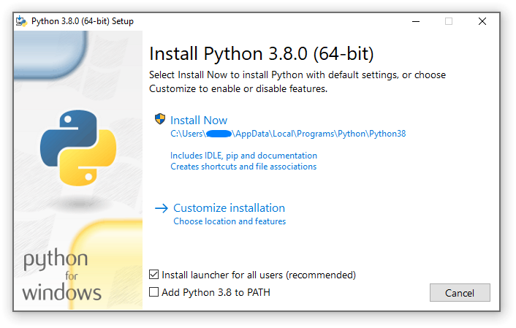

Slide 17
Writing my first Python Program
print(“Hello World”)
Output : Hello World

Slide 18
“Let’s come TOGETHER
to
LEARN & GROW”
Team DevScript

Slide 19
Thank You !!

